Slide 1

Friday 16th May
What exciting and simple experiments can I try with my child at home?
Mr Siddique

Slide 2
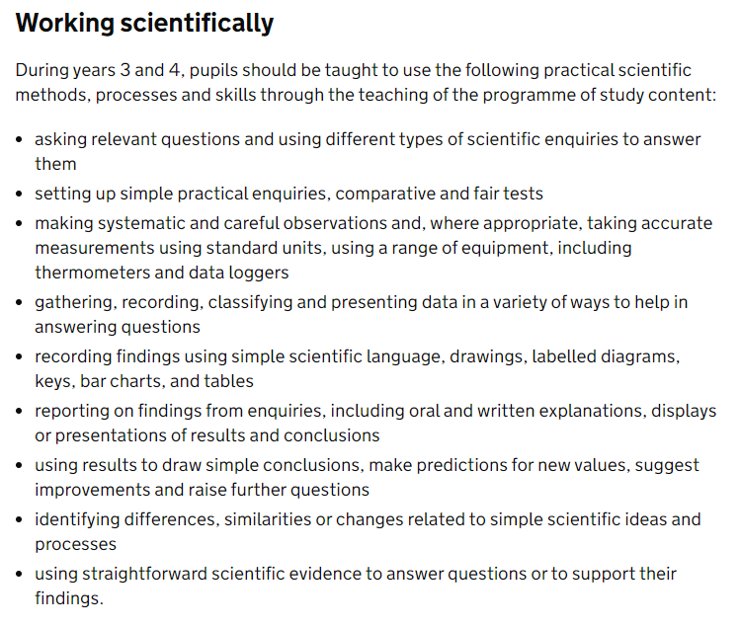
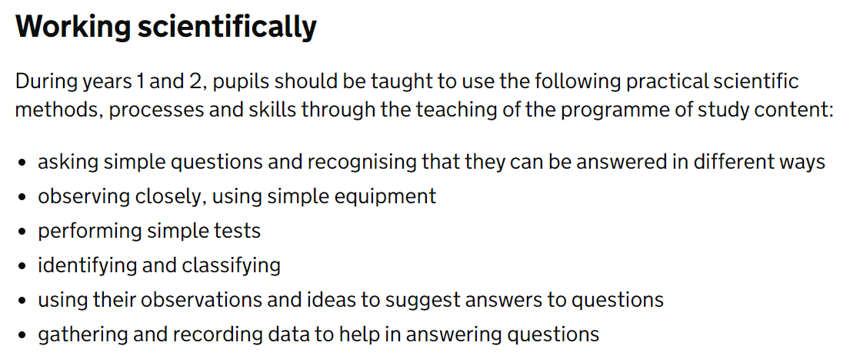
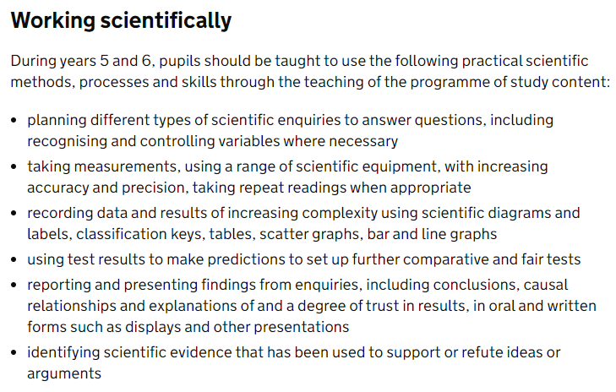
National Curriculum – Scientific Skills

Slide 3
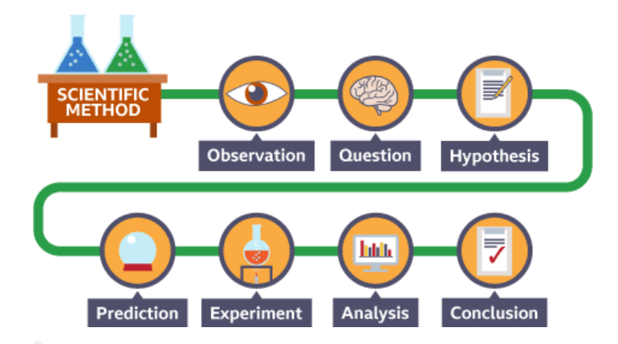
Investigation Skills
The key skills we teach children are:
How to set up an experiment
How to make an accurate prediction
How to understand what they have found
How to interpret the data
How to represent data: table, graph, diagrams etc.
How to draw conclusions

Slide 4
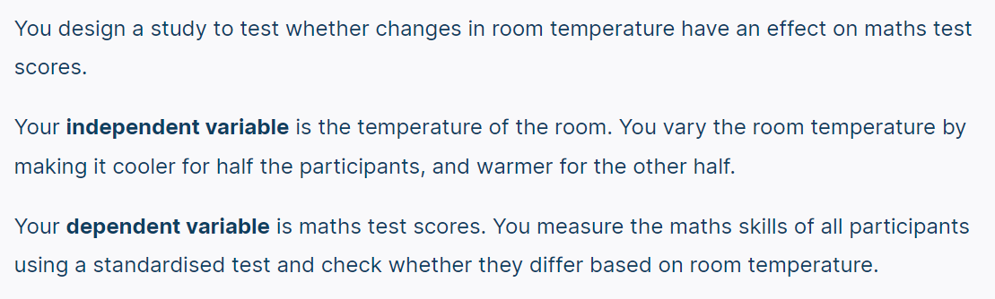
Vocabulary
The independent variable is the cause. Its value is independent of other variables in your study.
The dependent variable is the effect. Its value depends on changes in the independent variable.

Slide 5
Planning our experiment:
Which liquid will most effectively clean the coins?
How will we ensure our test is fair?
What will our variables be?

Slide 6
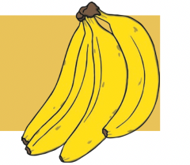
Investigation 1
Banana message
Can you make a message appear on the banana?
You will need:
Bananas
Cocktail sticks
Top tip: don’t break the skin!

Slide 7
How to carry out an investigation:
First, let us observe our materials.
What could our question be?

Slide 8

Our method:
Our prediction:
First, I will…
Next, I will…
Then I will…
Finally, I will…
I predict that…
I think this because…
Pattern seeking/relationships
Chanting
Inverse

Slide 9
When you scratch or press into a banana's skin, you're actually damaging it a little. Inside the banana, there's a special chemical called polyphenol oxidase (that’s a big name!). When the skin gets damaged, this chemical meets the air and causes the scratched part to turn brown.
Bananas also make a gas called ethylene that helps them ripen. This gas also makes the browning happen faster. That’s why, after a little while, your message appears on the banana like magic!

Slide 10
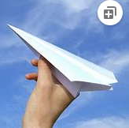
Investigation 2
Paper aeroplanes
Do materials affect how far the aeroplane will travel?
Do any make it go further? Which material works best?
You will need:
Card
Paper

Slide 11
How to carry out an investigation:
First, let us observe our materials.
What could our question be?

Slide 12
Our method:
Our prediction:
First, I will…
Next, I will…
Then I will…
Finally, I will…
I predict that…
I think this because…
Pattern seeking/relationships
Chanting
Inverse

Slide 13
Usually, the paper plane will fly further. This is because paper is lighter than card, so it can glide through the air more easily. A card plane is heavier and might not stay in the air as long.
But! If the paper is too thin, the plane might bend or wobble. If the card is not too thick, and the shape is good, it might fly well too.
Although card may withstand air resistance and turbulence and may travel farther.

Slide 14
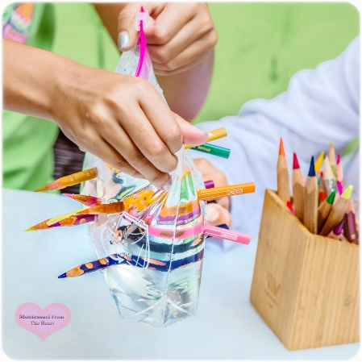
Investigation 3
Zip bag and pencils
Can you poke the pencils through without any water getting out?
You will need:
Plastic bag
Pencils
Top tip: make sure your pencils are sharp and there
is no air in the bag!

Slide 15
How to carry out an investigation:
First, let us observe our materials.
What could our question be?

Slide 16
When you poke a sharp pencil through a plastic bag filled with water, something amazing happens — the water doesn’t leak out! That’s because the plastic is made of something called polymers. These are long, bendy chains of tiny pieces stuck together.
When the pencil goes through the bag, these chains move around it and squeeze tightly, making a seal so the water stays inside. It’s like the plastic is giving the pencil a big hug to stop any leaks!
Polymers are really big molecules made of lots of smaller parts called monomers. You can think of them like a necklace made of beads — each bead is a monomer, and when you link lots of them together, you get a long chain called a polymer.
Things like plastic, rubber, and even the DNA inside your body are made of polymers!

Slide 17
Our method:
Our prediction:
First, I will…
Next, I will…
Then I will…
Finally, I will…
I predict that…
I think this because…
Pattern seeking/relationships
Chanting
Inverse

Slide 18
Conclusive thinking
From the investigation, I can see that…
Our experiment showed that…
This tells me that…
These findings are the same/different to my prediction because…
I think that if I…
We kept this a fair test by…
We ensured that we…
This meant that our results were…

Slide 19
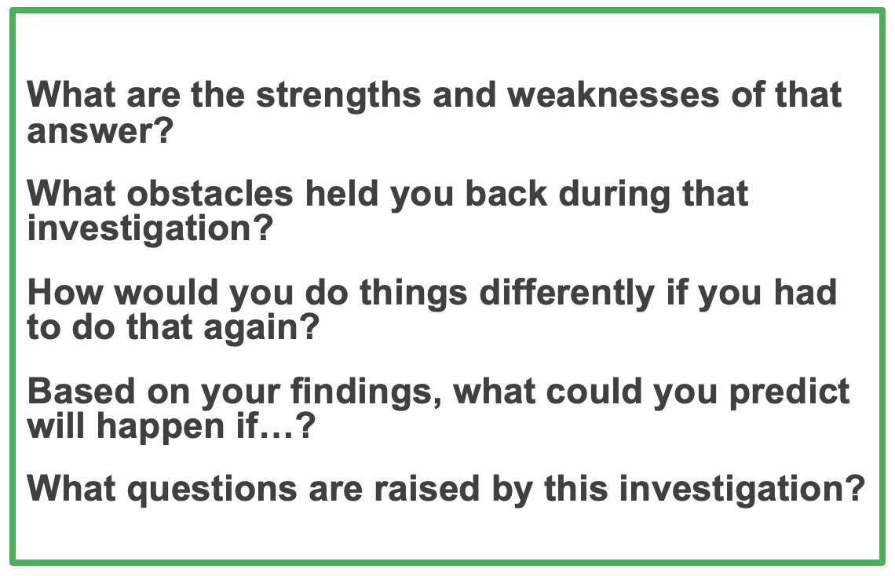

How effective was our investigation?

Slide 20
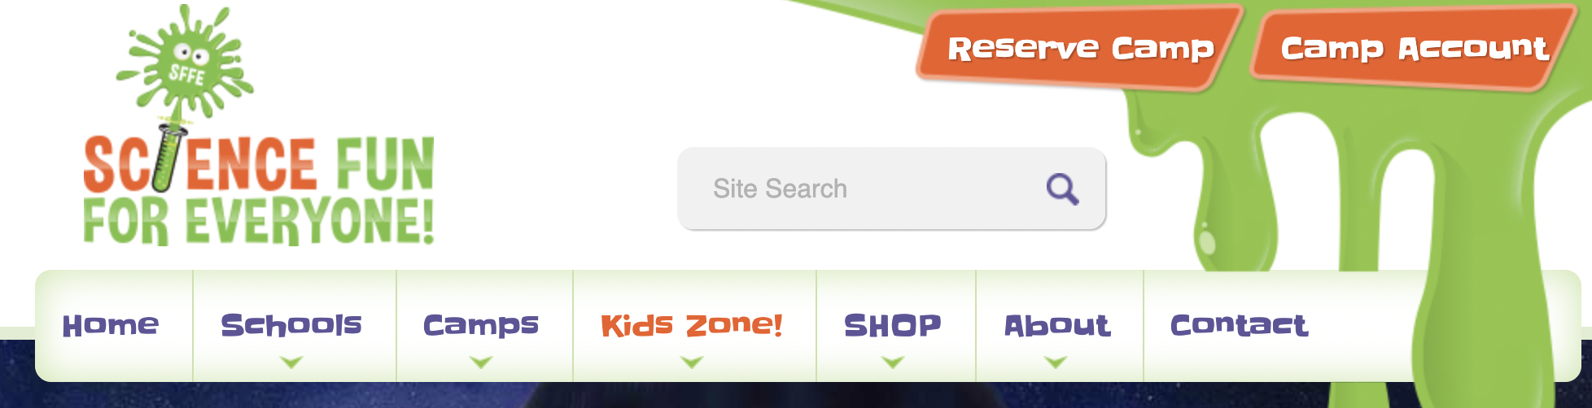
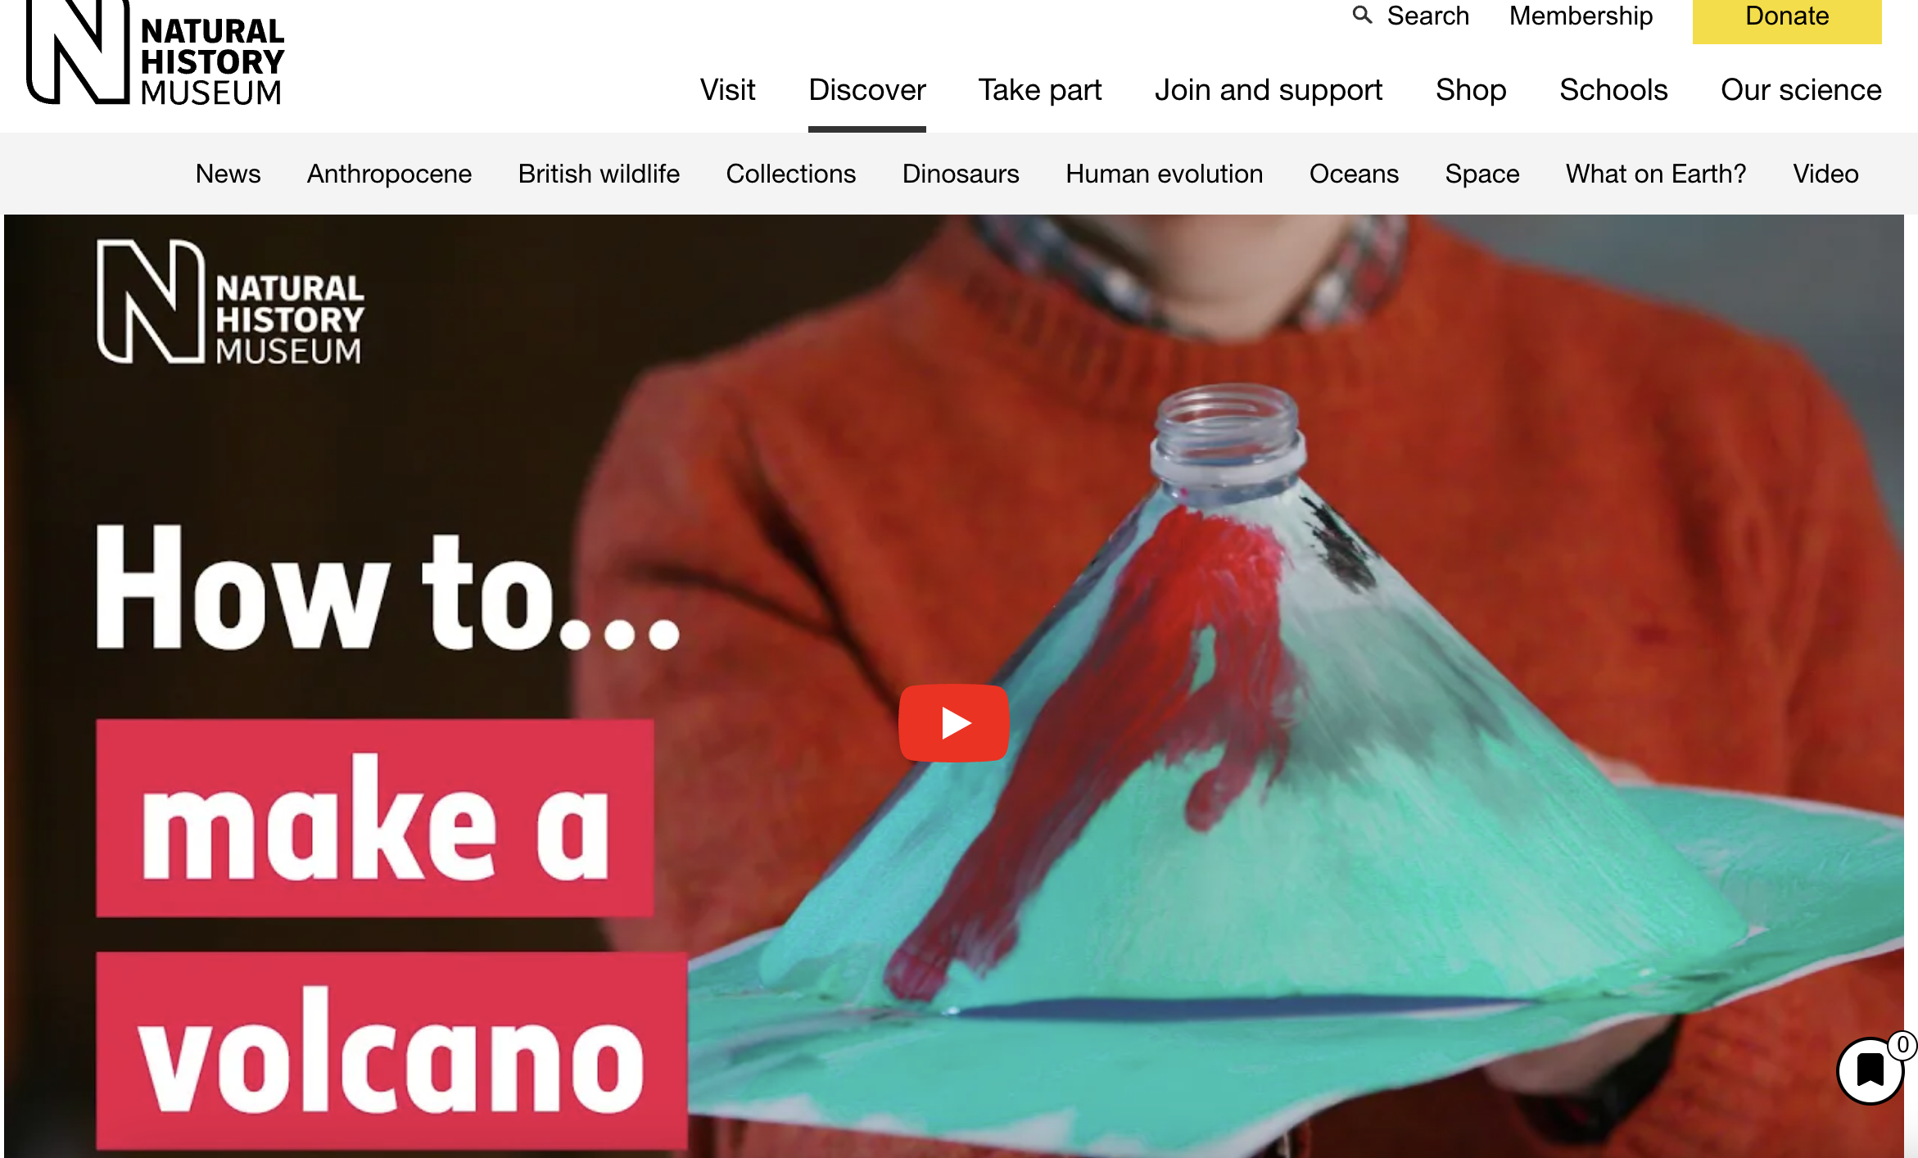

Websites

Slide 21
Links:
https://learning.sciencemuseumgroup.org.uk/learning-resources/community-science/
https://www.nhm.ac.uk/schools/teaching-resources.html?gclid=Cj0KCQjw166aBhDEARIsAMEyZh7lb71JRhheiVTvawsjbnmYAZ3ug0avyR-56O5Um0eLujgMu642PbQaAmmbEALw_wcB
https://www.sciencefun.org/kidszone/experiments/
https://littlebinsforlittlehands.com/science-experiments-and-activities/
https://pstt.org.uk/resources/curriculum-materials/Science-Fun-at-Home?gclid=Cj0KCQjw166aBhDEARIsAMEyZh6U4TN2jd5nbG5ALUNaJiFlyodXxenufiJ8SgasFrysgQPpIYYeyTQaAo3PEALw_wcB

