Slide 1
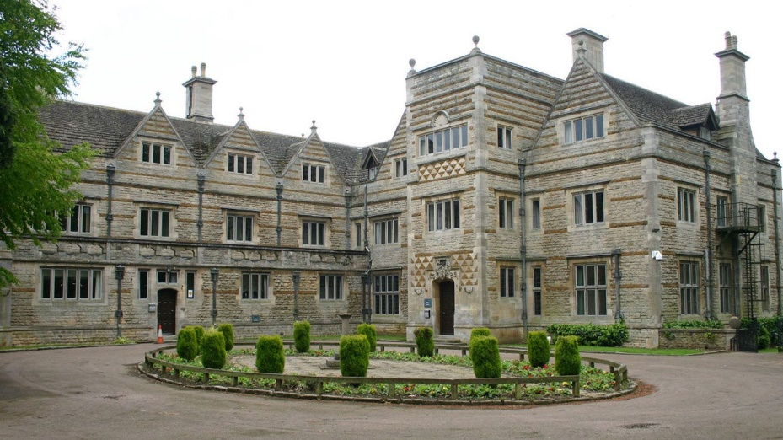
Year 6 Residential PGL Lincolnshire Monday 11th July – Wednesday 13th July 2022. Parent Information Presentation

Slide 2
PGL Lincolnshire
65 acres of grounds surrounding a huge mansion house
Grantham – Lincolnshire
2 nights and 3 days, travelling by coach
Packed full of adventure activities on land and water
Everything is included – the activities, equipment, accommodation and food.

Slide 3
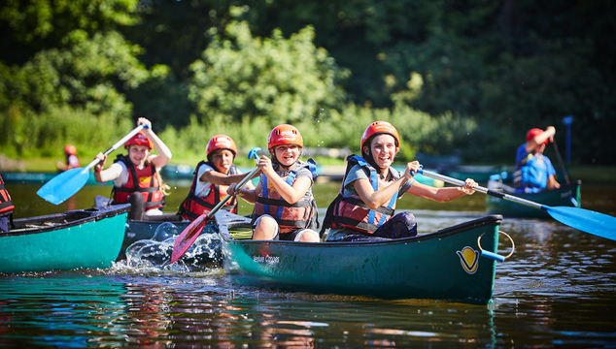
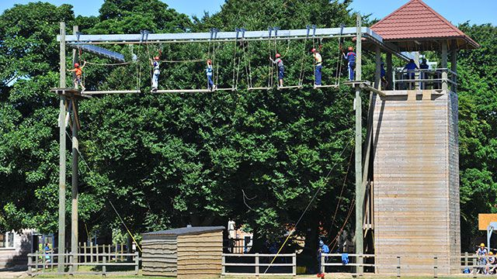
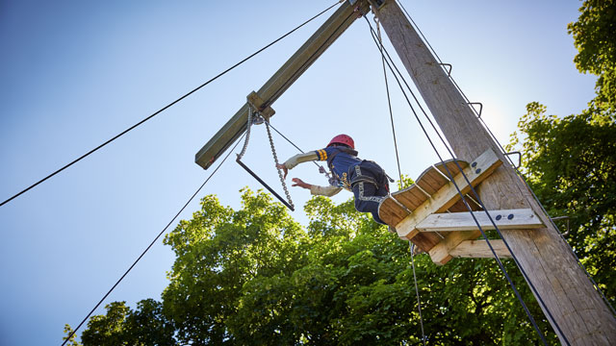
Activities
23 activities to choose from
(See drop down on website)
https://www.pgl.co.uk/en-gb/school-trips/primary-schools/centres/caythorpe-court?gclid=EAIaIQobChMI8vy0jrXo9AIVCLrtCh0megeWEAAYASAAEgLL1vD_BwE

Slide 4
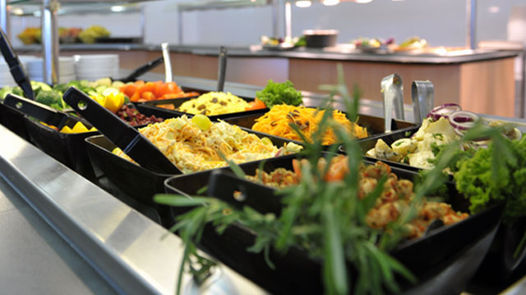
Food
Enjoyable mealtimes with nutritious and tasty food Our meals are freshly cooked, balanced and will give your pupils plenty of energy to keep them going throughout the day.
Hot and cold meals with vegetarian options
Homemade soup every day
Self-service salad bar
Fresh fruit with every meal
Allergies, intolerances and special diets catered for

Slide 5
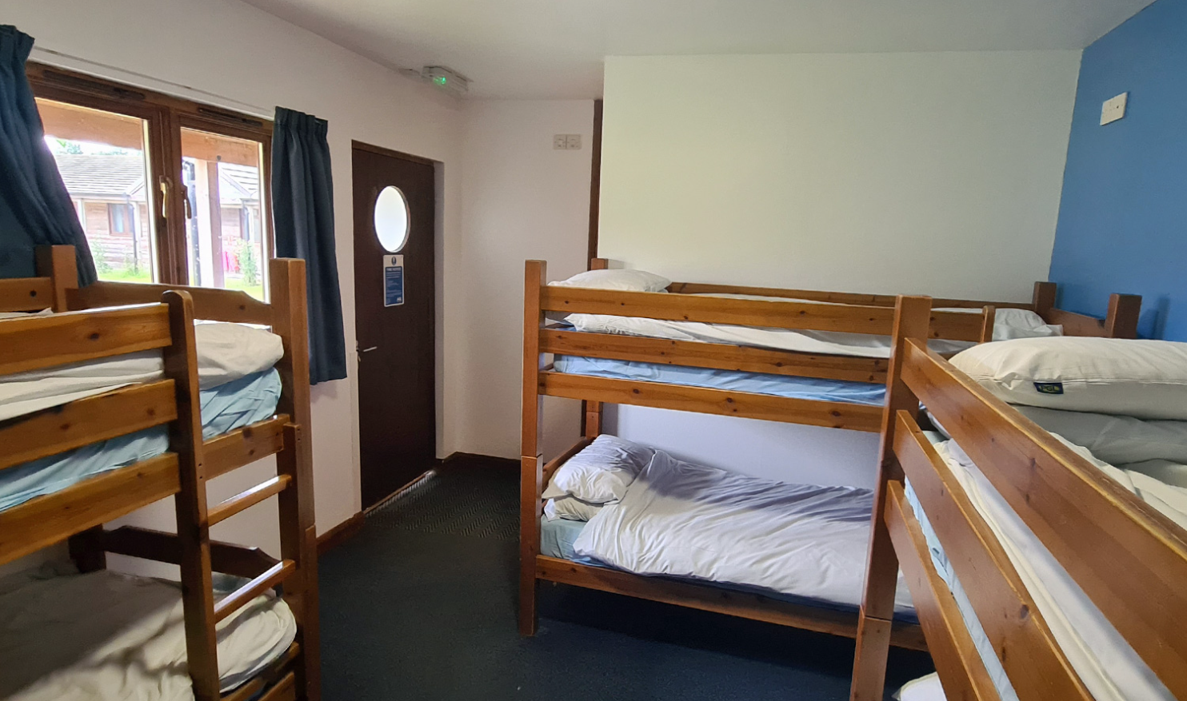
Accommodation
Dormitory-style rooms in a range of accommodation blocks and lodges.
En suite rooms with bunk beds sleep 3-8

Slide 6
Sample Day
Schedule | Activities
7:00-8:50 | Get up, get ready and fuel for the day ahead with a healthy, hearty breakfast.
8:50 – 12:00 | Morning activities – 2 sessions with a 10 minute break in between.
12:00 – 13:50 | Enjoy a fresh and tasty two course hot lunch and some free time
13:50 – 17:00 | Afternoon activities – 2 sessions with a 10 minute break in between
17:00 – 19:00 | Time to eat again – a different dinner menu each day
19:00 – 21:00 | Discos, campfires, quizzes and more – our evening entertainment programme keeps every one engaged until bed time
21:00 – 21:30 | Bedtime

Slide 7
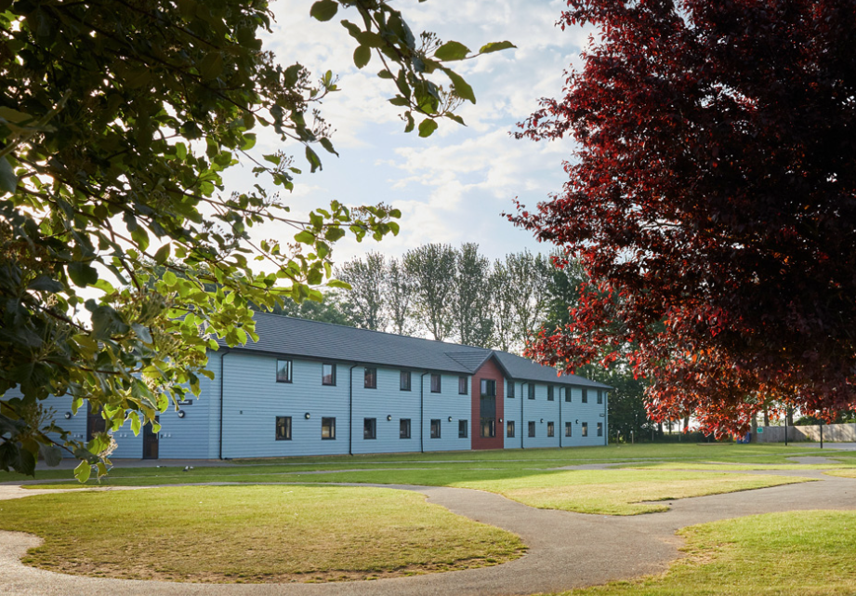
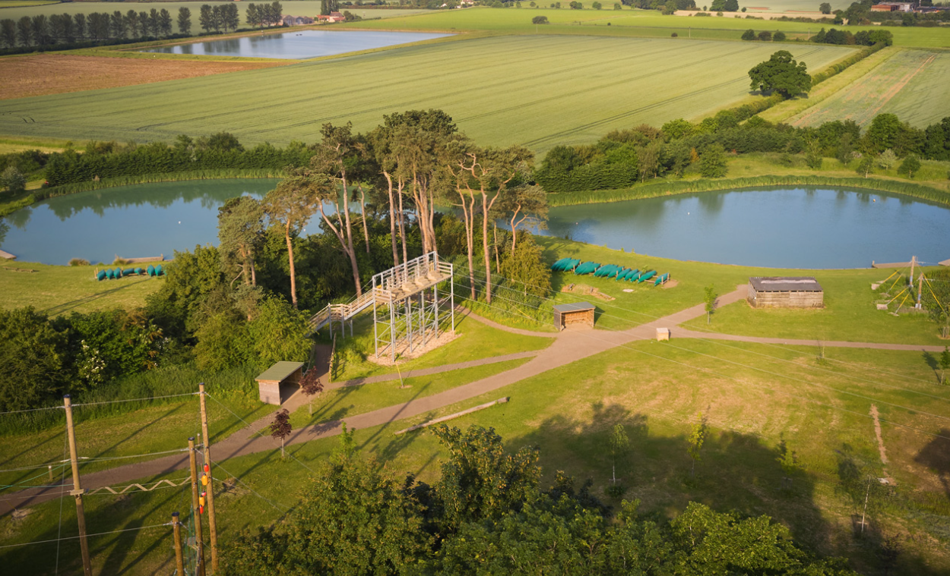
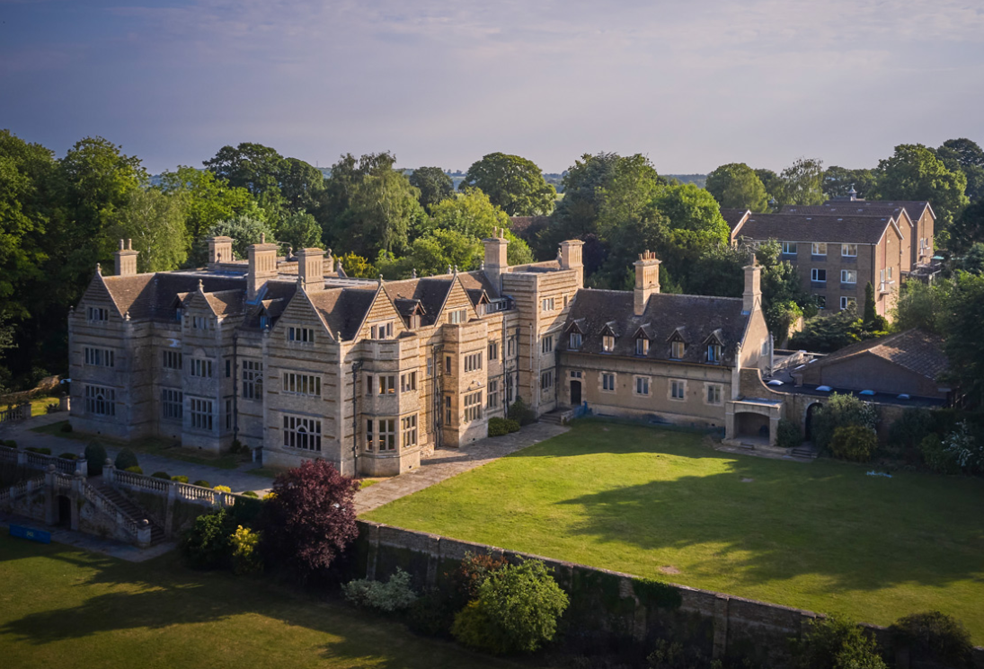
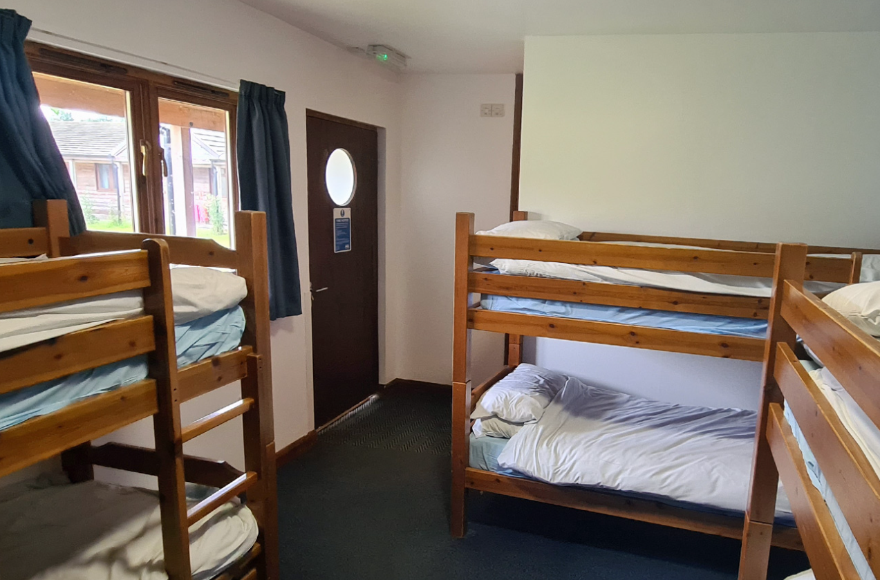
Find out more…
PGL Caythorpe Court Caythorpe Grantham Lincolnshire NG32 3ER
www.pgl.co.uk

Slide 8
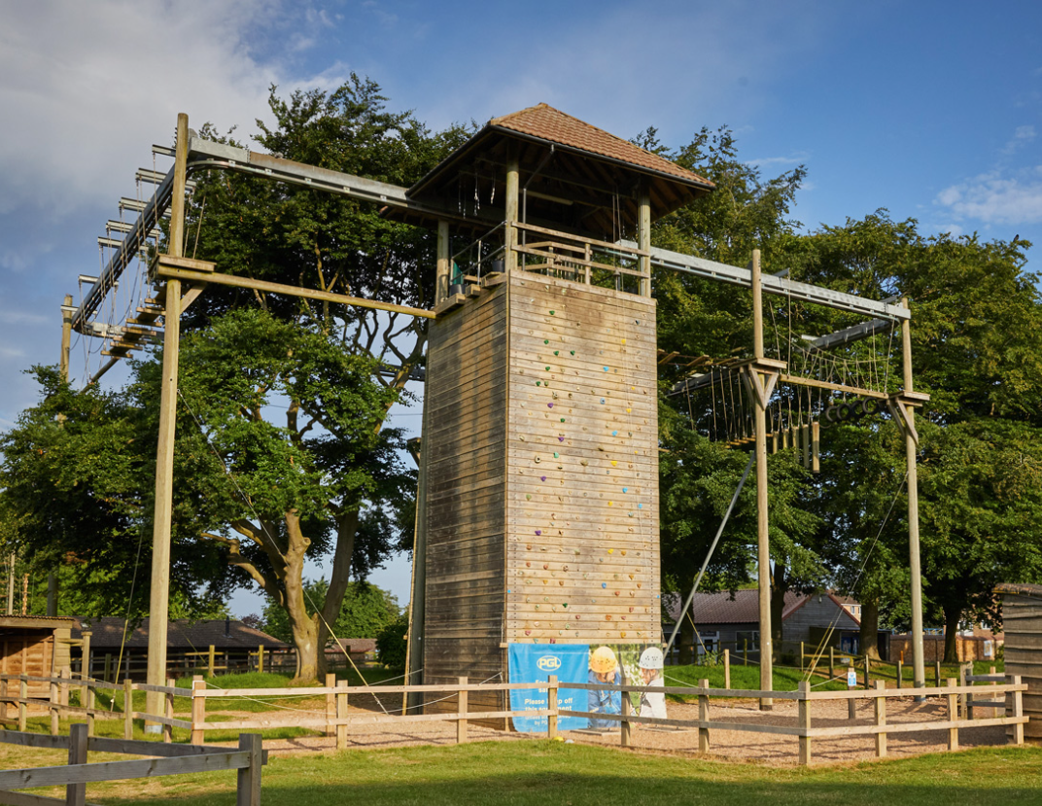
Costing
The price including all transport is £110. Children that recieve free school meals are then elgible for a further discount of £50, bringing the total to £60.
You can pay in full or in three instalments:
Non free-school means £110 (£30, £40 and £40)
Free-school meals £60 (£20, £20 and £20)

Slide 9
Questions?
Please return slips as soon as possible. Spaces for Kench Hill fill up fast, so don’t miss out! The deadline for first payments to be given to the school office is Friday 14th January 2021.

