Slide 1

Mi ciudad
LI: To use strategies to memorise vocab
Context: name some places in the town in Spanish
SUCCESS CRITERIA
I can name at least 6 places (ask a partner to test you)
I can explain my detective clues to my partner
I I can match sentences to pictures using a model
Notes:
1

Slide 2


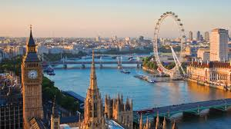
Practica/practice the question/answer
¿Dónde vives?
Help
© 2009 Microsoft Privacy Terms of use
Help
© 2009 Microsoft Privacy Terms of use
Help
© 2009 Microsoft Privacy Terms of use
Help
© 2009 Microsoft Privacy Terms of use
Code of Conduct Report Abuse Account Feedback
Code of Conduct Report Abuse Account Feedback
Code of Conduct Report Abuse Account Feedback
Code of Conduct Report Abuse Account Feedback
Vivo en Londres.

Slide 3
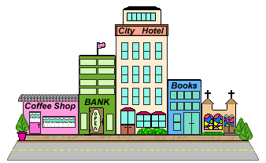
Escucha y repite//Listen and repeat
En mi ciudad tengo…
In my city I have…

Slide 4
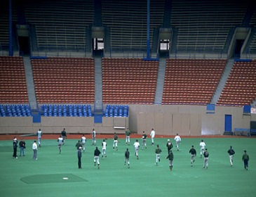
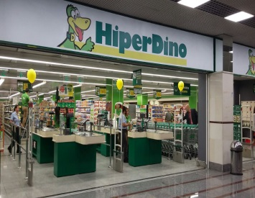
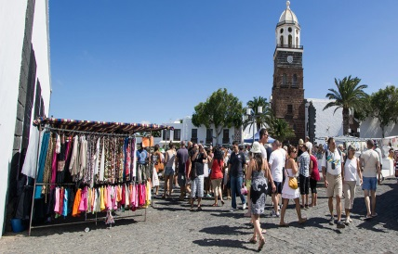
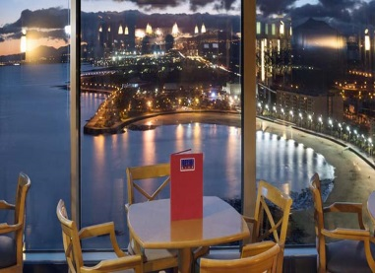
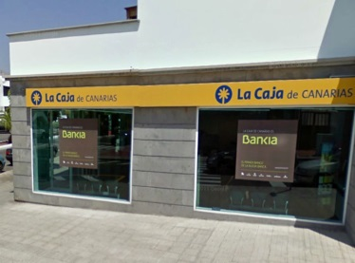
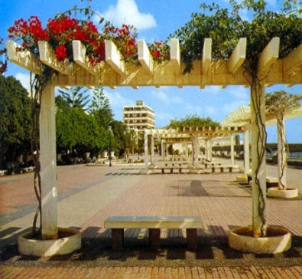
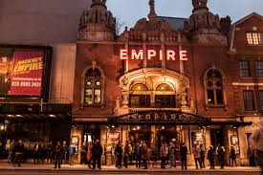
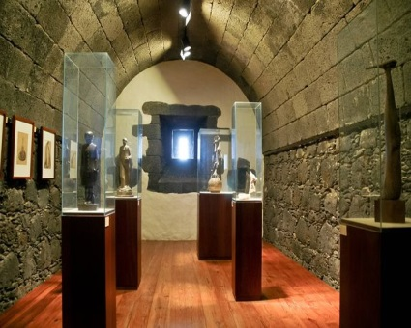
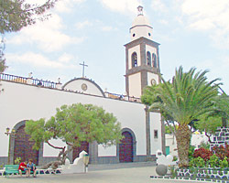
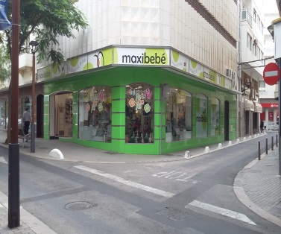
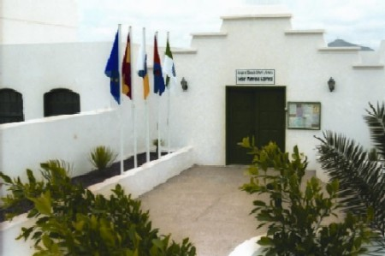
Repite, por favor. - Repeat, please.
un estadio
un supermercado
un mercado
un restaurante
un banco
un parque
un hospital
un cine
un teatro
unos museos
una iglesia/
una mesquita
una tienda
unas escuelas

Slide 5
¿Qué falta?/Say what is missing

Slide 16
Practica el alfabeto//practice the alphabet
a | b | c | ch
d | e | f | g | h | i
j | k | l | ll | m | n | ñ
o | p | q | r | s
t | u | v | w | x | y | z
Challenge!.
Spell a place in the town using your Spanish sounds. Can your partner guess what it is?
Notes:
Thnk of a letter using one of the lines. 3 guesses

Slide 17
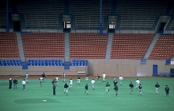
LI: To use strategies to memorise vocab Context: name some places in the town in Spanish SUCCESS CRITERIA I can name at least 6 places (ask a partner to test you) I can explain my detective clues to my partner I can write down my detective clues.
SA |  | PA |  | TA
CT | OA |  | Independent
A.-Escribe frases//
Write sentences using your whiteboards:
En mi ciudad tengo un cine.
un cine, un teatro, un estadio, una tienda, unas escuelas, una oficina de correos, un parque, un hospital, un mercado, un restaurante, un banco, una iglesia, un supermercado, un museo,
1.- En mi ciudad tengo un estadio.

