Slide 1
WK5
las asignaturas
To write independently using resources.
Context: School Subjects
SUCCESS CRITERIA:
I can use my help sheet or dictionary to support my vocab or spelling.
I can write some personal information
I write and give my opinion about school subjects
I can say what my partners likes and dislikes using the 3rd person.

Slide 2
Begin with a greeting. Hola, me llamo..
Say your name and describe your hair and eyes. Tengo el pelo/los ojos..
Say where you live. Vivo…
Give your opinion about school subjects (2 positive and 2 negative.)
Me gusta…
Say something your partner likes or dislikes (1 thing).
A Ana le gusta…
Say goodbye.
Check work.
Use this model, your vocab sheet and the writing frame to help you write about yourself.

Slide 3
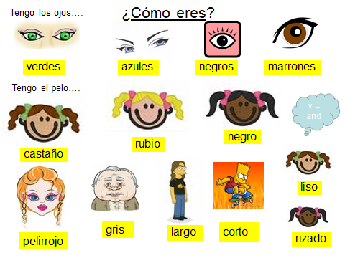
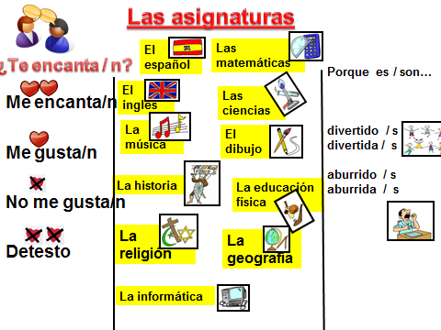
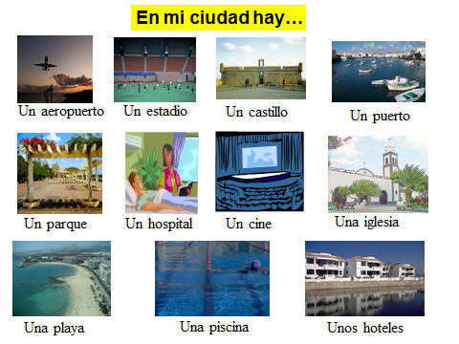
HELP SHEET

Slide 4
WRITING FRAME
Hola,
Me llamo___________________.(name)
Tengo____________años. (age)
Vivo en __________________ (area)
Tengo el pelo _________________ (colour)
Tengo los ojos_________________ (colour)
Tengo ______hermanos.
Me gusta ____________porque es____________(subjects)
No me gusta_________porque es____________(subjects)
Adiós.

