Slide 1
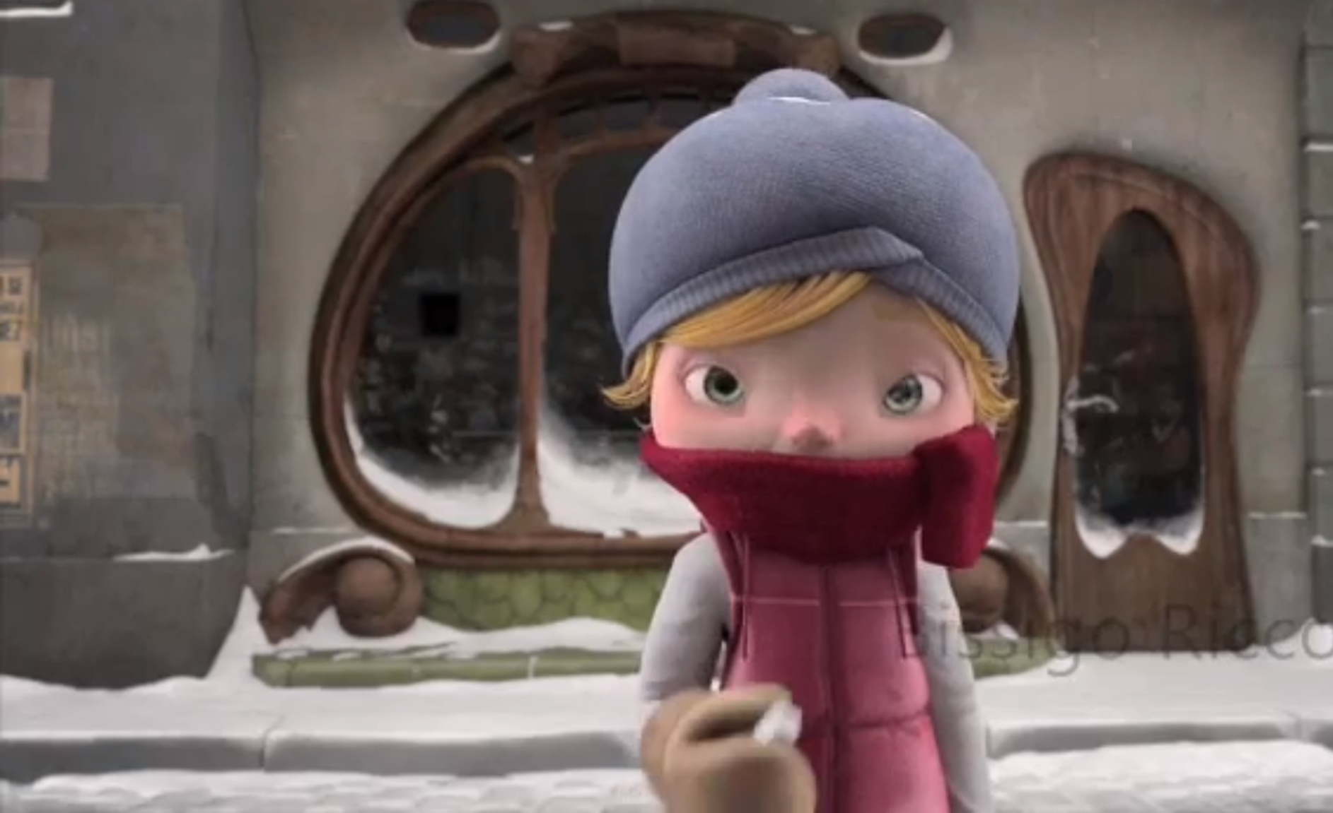
Wk 4
L.I.: To complete a description.
Context: Spanish animation
SUCCESS CRITERIA
I can use verbs in the third person to write a missing poster.
I can use Spanish gender and number agreements.
I can include connectives and negatives to improve my work
Alma

Slide 2
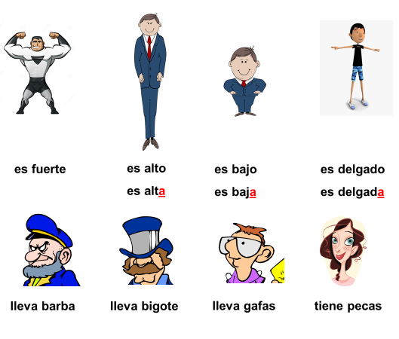
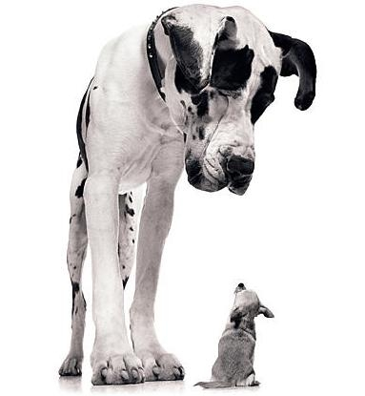
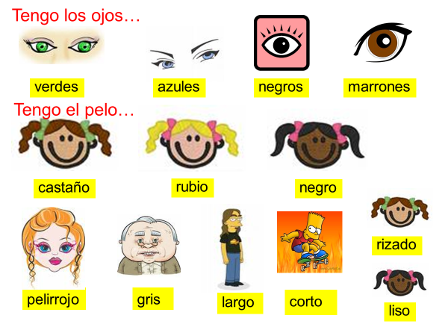
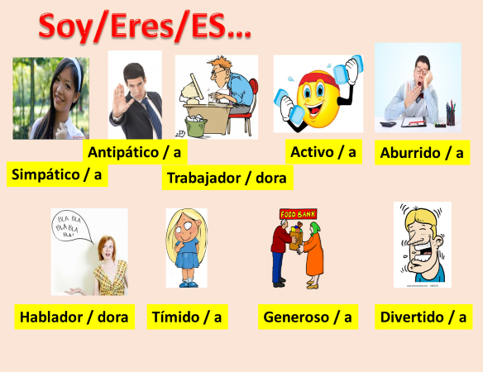
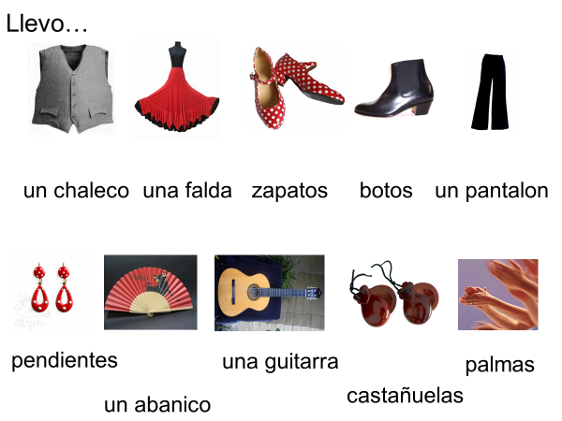
Tengo = I have, tienes = you have, tiene=he/she has
Soy = I am, eres = you are, es =he/she/it is
Practica =
Practice
grande
pequeño
Llevo /llevas/ lleva = I wear/ you wear / he,she,wears,

Slide 3
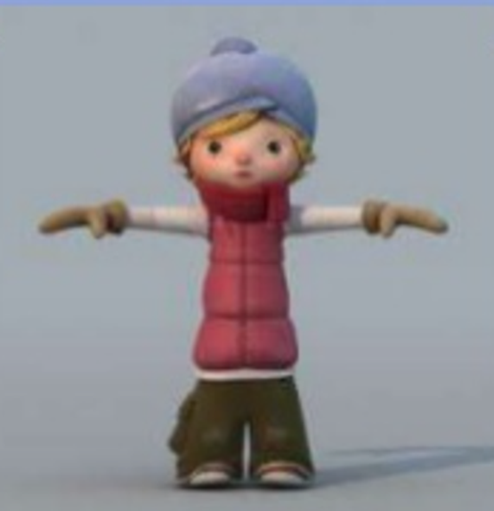
La revisión
Complete the sentences about Alma. Remember to add connectives and negatives to improve and extend your text. Use your vocab sheet to help you.
EXTENSION:
y, pero, tambien
Negativo (no tiene..)
Se llama________________
Es___________, ____________, ______________.
Tiene_____________
Lleva________________
Siente________________
Extension extra: use vive en, es de…
Online dictionary = www.wordreference.com

Slide 4
Extra
Now practise your understanding ofusing different parts of a verb to write about yourself in the 1st person. Remember to use connectives and negatives (No tengo…)
Remember to use the 1st person and your vocab sheet to help you.
Me llamo________________
Soy___________, ____________, ______________.
Ten…_____________
Llev…________________
Sient…________________

