Slide 1

L.I: To ask and answer a question in Spanish. Context: birthday
Wk4
Success criteria:
I can recall previous vocabulary with support
I can ask a question using intonation.
I can say my birthday with support.

Slide 2













https://www.youtube.com/watch?v=IKznbHvPFwc

Slide 3

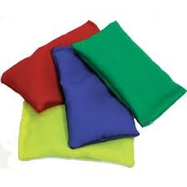
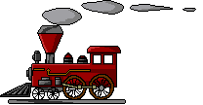
Try clapping the numbers
Throw a beanbag to a partneras you say the numbers
0 | 1 | 2 | 3 | 4 | 5 | 6 | 7 | 8 | 9 | 10 | 11 | 12
13 | 14 | 15 | 16 | 17 | 18 | 19 | 20
21
30
31

Slide 4

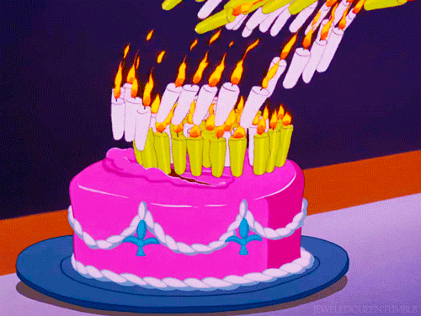
¿Cuándo es tu cumpleaños?
Es el (number)de (month)
3
20

Slide 5
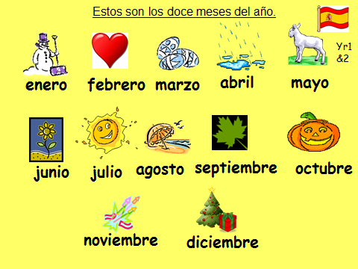
0 | 1 | 2 | 3 | 4 | 5 | 6 | 7 | 8 | 9 | 10 | 11 | 12
13 | 14 | 15 | 16 | 17 | 18 | 19 | 20
21
30
31
Practise the birthdays of different members of the family. Use slide 4 to help you.

