Slide 1
Develop an understanding of how we teach and differentiate for children with special educational needs
Rachael Carr
Deputy Headteacher (Inclusion)

Slide 2
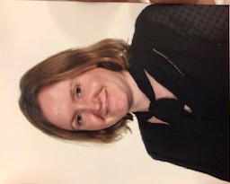
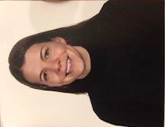
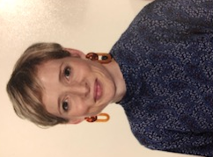
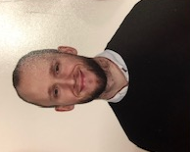
Meet The Team
Mrs Baez
AHT/SENCo
Miss Headen
EYFS Phase Leader
Laura Goulden
Unlocking Potential
Miss Buttery
Learning Mentor
Mr Ward
Learning Mentor

Slide 3
The IQM inclusive school award recognises the on-going commitment by schools to provide the very best education for all children irrespective of differences.
The overarching aim of Flagship status is that an individual school which has achieved this status can now further its work in Inclusion through internal research activities.

Slide 4
“Every teacher is a teacher of special educational needs.”

Slide 5
4 areas of SEND:
Social, emotions and Mental Health (SEMH)
Communication and Interaction
Cognition and Learning
Sensory and/or Physical Needs

Slide 6
Specialist – external agencies
Targeted - Interventions
Universal – High Quality Teaching

Slide 7
High Quality Teaching
Knowledge
Teaching/Modelling
Classroom Climate
Classroom Management
Training for all staff

Slide 8
Differentiation
Modifications of:
Content of the lesson
How learning is presented
Environment
Outcome
How Orchard differentiate for children with SEND through high quality teaching:
Be explicit
Range of resources – concrete and visual
Recapping prior learning and making links
Repetition
Simplified language
Modelling
Memory aids –task planners

Slide 9
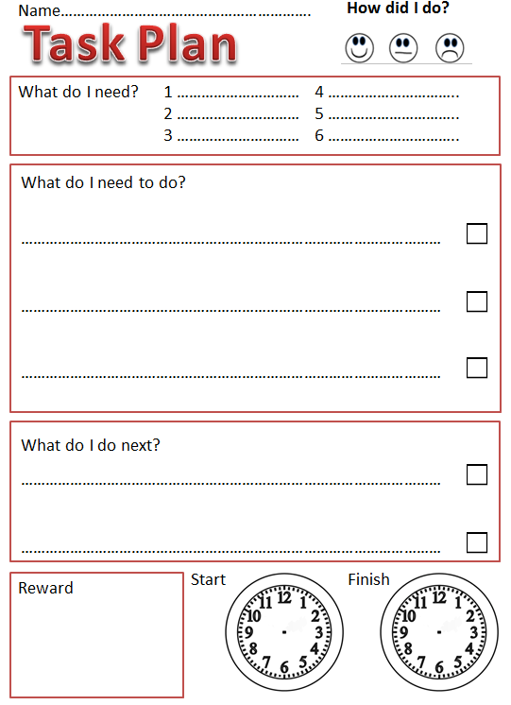
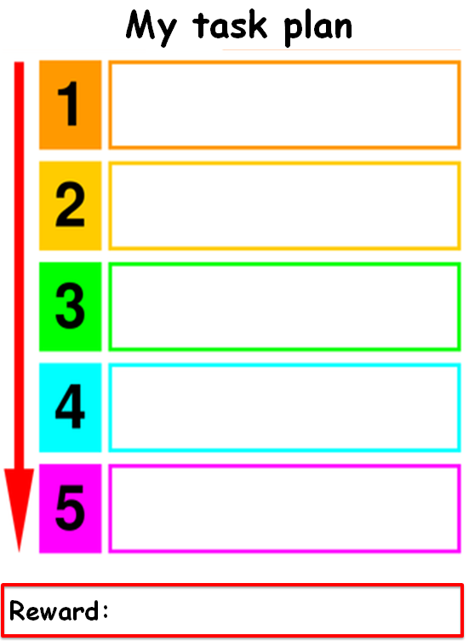

Slide 10
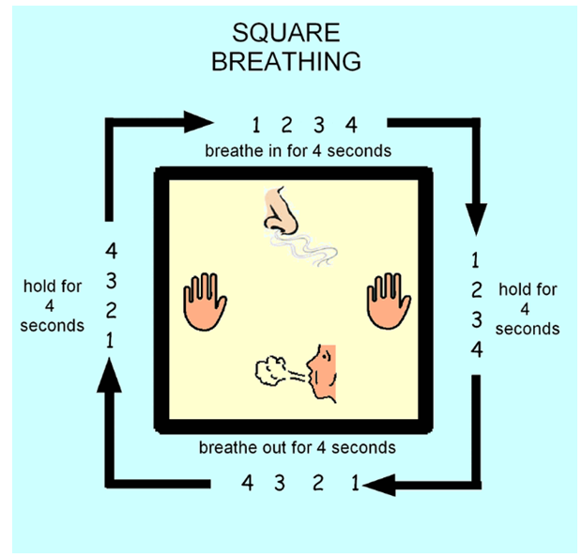

Slide 13
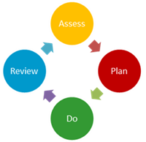
Targeted – Interventions
Speech and Language
Launchpad
Sensory
Attention Autism
Precision Teaching
1:1 Reading
Social Skills/Managing feelings
Circle of Friends
Zones of Regulation
Symphony
Lexia
Staff Training
Quality Assurance

Slide 14
Specialist – External Agencies
Speech and Language Therapists
Unlocking Potential – therapeutic support
Specialist teachers
Educational Psychologists
Staff Training
Quality Assurance

Slide 15
Parental involvement
Our school recognises the importance of working in partnership with parents in order to offer quality provision in the area of SEND.
The school aims to respond effectively to parental concerns regarding their child’s individual needs and act appropriately.
The SEND team will aim to develop effective mechanisms for parental involvement and the sharing of information:
We aim to:
Inform parents when difficulties are first identified by the class teacher.
Respond to any concerns raised by parents and arrange meetings with the Head teacher and/or Deputy Head teachers to discuss these.
To inform parents about the implementation of Personal Learning Goals.
Develop home/school programs for children if the need arises.
To inform parents and get their views when the school is considering contacting outside agencies for further advice and support.
Direct parents to the appropriate agencies if they want to seek further advice and support themselves.
Facilitate meeting between outside agencies are parents when needed

