Slide 1
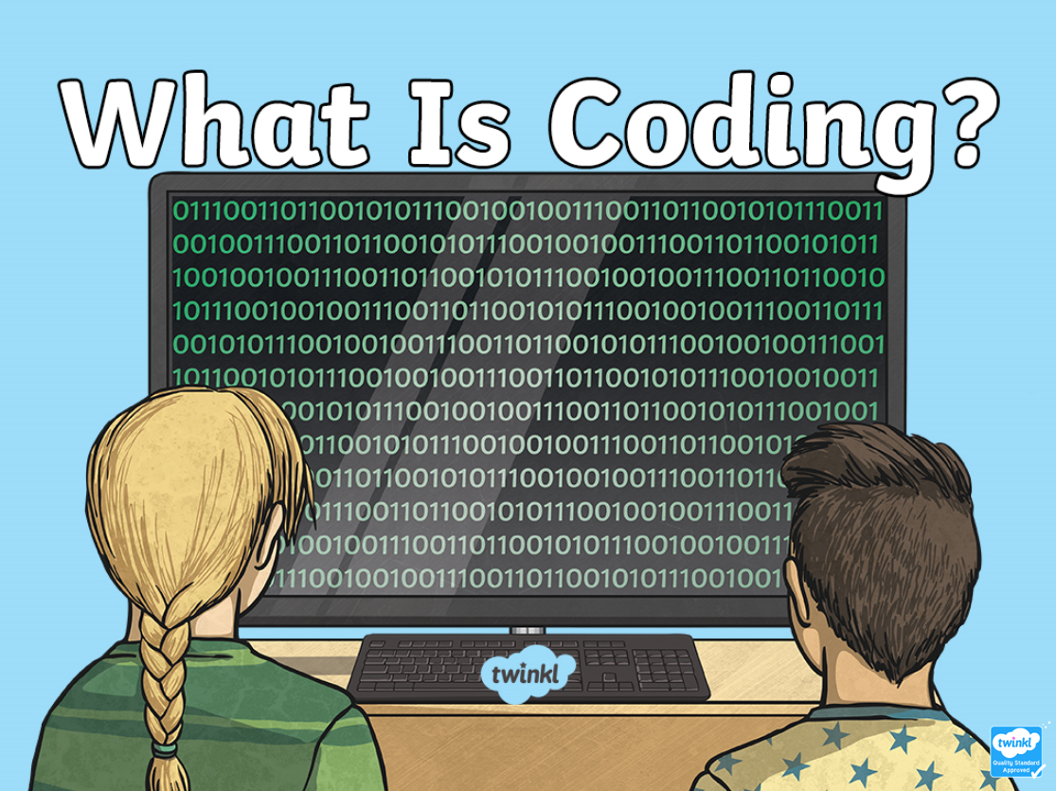

Slide 8
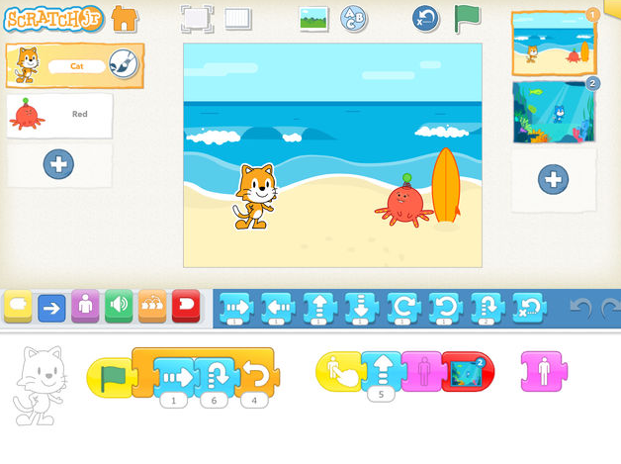
Now let’s try out Scratch Jr!

Slide 9
Now let’s try out Scratch Jr!

