Slide 1
Numeracy Coffee Morning
Be in the know! Learn new methods to solve maths problems
Mr Siddique

Slide 2
Concrete, pictorial and abstract, vocabulary building
Calculation policy

Slide 3
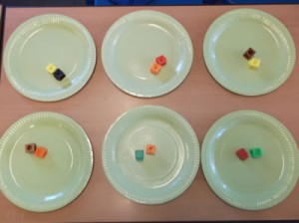
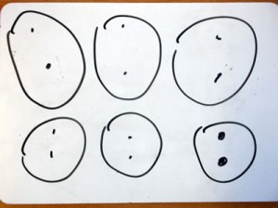
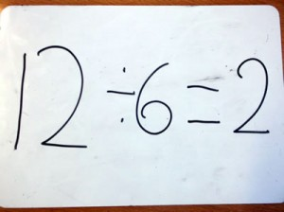
Concrete
Pictorial
Abstract

Slide 4
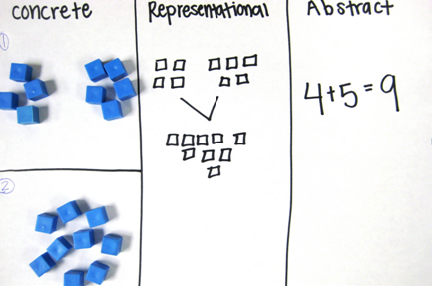

Slide 5
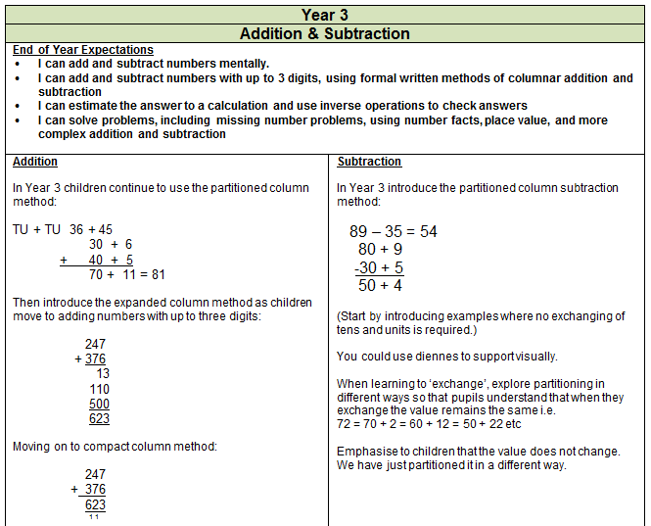
Calculation policy
Ensures progression of skills across year groups

Slide 6
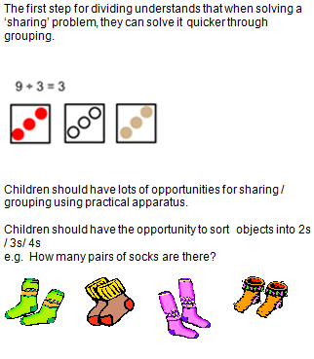
Let us explore division!
Year 1

Slide 7
Using mini WB or cubes, show me concrete/pictorial representation: of the following
There are 12 bulbs. Plant 3 in each pot. How many pots are there?
Jo has 12 Lego wheels. How many cars can she make?

Slide 8
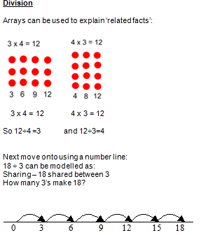
Year 2

Slide 9
Using mini WB or cubes, show me concrete/pictorial representation: of the following
Kia, Harry and Jane shared 15 red roses between themselves. How many roses does each child get?
18 ÷ 6

Slide 10
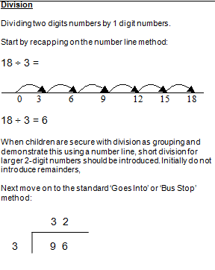
Year 3

Slide 11
Using the bus stop method, solve the following:
45 ÷ 9

Slide 12
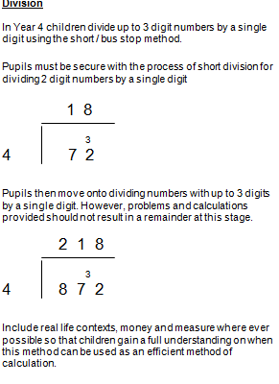
Year 4

Slide 13
Year 5

Slide 14
Using the bus stop method, solve the following:
45 ÷ 8 =
32 ÷ 5 =

Slide 15
Year 6

Slide 16
Example
528 ÷ 24 =
528 88 =

